Slide 1

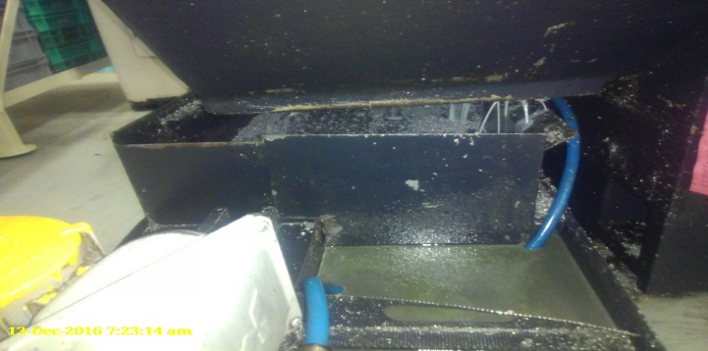
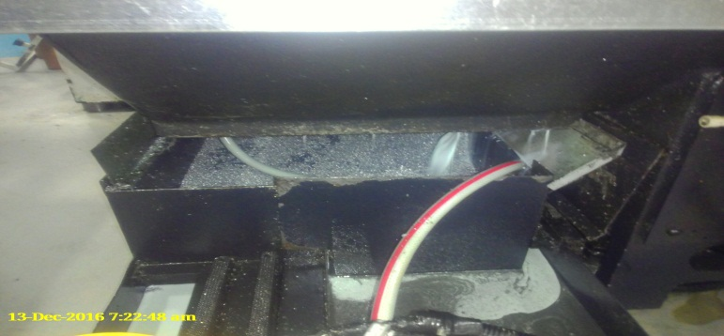
P15
TPM CIRCLE NO :- 01
ACTIVITY
KK
QM
PM
JH
SHE
OT
DM
E&T
KAIZEN IDEA SHEET
TPM CIRCLE NAME: Achiever
LOSS NO. / STEP
DEPT :- MACHINE SHOP
RESULT AREA
P
Q
A
B
C
D
S
M
CELL:- A105 FL WT
CELL NAME
MACHINE / STAGE
OPERATION
KAIZEN THEME : To eliminate coolant leakage
IDEA: Provide Gard on coolant tank
PROBLEM PRESENT STATUS:: Coolant leakage on shop Flore
COUNTERMEASURE:- Coolant leakage
BENCHMARK
TARGET
0
KAIZEN START
6
TDC
KAIZEN FINISH
TEAM MEMBERS: Vinod Jadhav, S Wgchoure,
Nitin Sutar, sujit
BENEFITS :-1) Reduce rejection
2) reduce setting time
Before
After
KAIZEN SUSTENANCE
WHY - WHY ANALYSIS :-
Why1 :-Coolant leakage
Why3: Machine coolant tank & machine body gap
Why4: coolant leakage in gap
Why5: Provide Gard between gap
RESULT :- Reduce coolant leakage
WHAT TO DO:-Close leakage
HOW TO DO: Provide Gard on coolant tank
FREQUENCY :-
SCOPE & PLAN FOR HORIZONTAL DEPLOYMENT
Sr No | CELL | TDC | RESP. | STATUS
1
2
ROOT CAUSE Coolant leakage :
REGISTRATION NO. & DATE: 28/11/2016
REGISTERED BY: Vinod Jadhav
MANAGER’S SIGN :- d y pawar
SINGLE TOOL IMPLEMENTED FOR GROOVING AND FACING

